Slide 1

Email Spam Filter
By Trang Do, Ethan Ennis, Maen Marashdeh & Patricia Aguilar Perez
CSC 425- Artificial Intelligence
Fall 2022

Slide 2

Introduction
Goals:
Implement the process of filtering spam emails.
Detect unwanted, unsolicited and virus-infected emails and move them to a spam inbox folder.

Slide 3
Introduction
Different filtering methods are used to identify:
Email content
Senders.
Spam filters base their judgement on different criteria.
Simple and easy method:
Watch for particular words on the subject lines of messages and exclude them from the user's inbox.

Slide 4
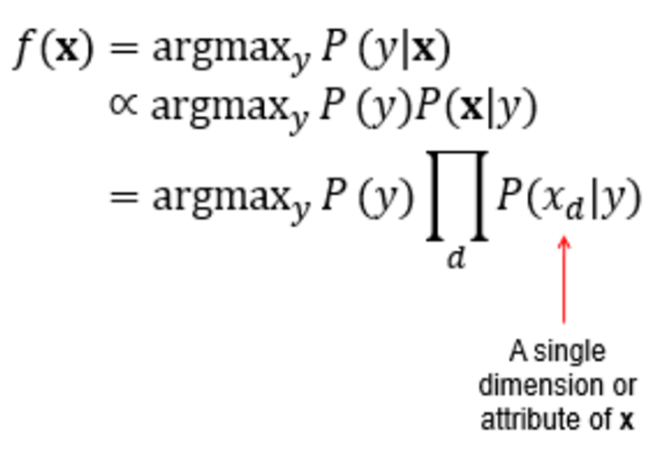
Multinomial Naïve Bayes Classifier
A probabilistic learning method.
Classifies emails based on the frequency of words in it.
Given sample x and a class label y that we want to find.
P(x|y) = Set of unknown samples.
∝ = proportional to.
indicates change in relation to something else.
Arg max = inputs or arguments, at which the function outputs are as large as possible.
This method classifies the email to the class with higher probability.

Slide 5
Project Dataset
Consists of 962 emails
Divided into different partitions of:
Training set.
Test.
Both datasets have equal number of normal emails (X-XXXmsgX) and spam emails (spmXXX).
D = all the email files.
d = one email text file.
Class labels
𝐶 = {𝑐1, 𝑐2} = {0, 1} = ham, spam
For each email, we have file and label pair:
E.g: < 𝑑, 𝑐 > = < X-XXXmsgX.txt,1>

Slide 6
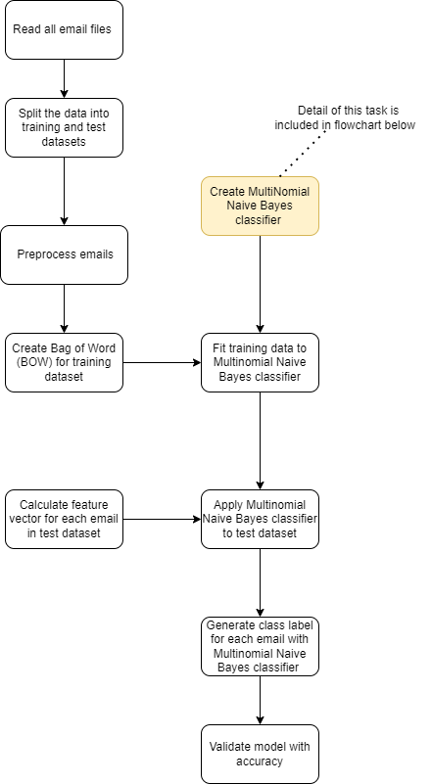
Project Methodology
Pseudo code
Step 1: Read all emails files
For each file in train and test folder
move to all_mail folder
End for
Step 2: Split data into training and testing set based on given training proportion
train_count = total_emails * train_proportion
count_ham =0
count_spam = 0
For each file in all_mail folder
if count_ham <= train_count //2 and file_name contains ‘msg’
move to train folder
count_ham +=1
end if
if count_spam <= train_count //2 and file_name contains ‘spm’
move to train folder
count_spam +=1
end if
End for
For each file in all_mail folder
move to test folder
End for
Step 3: Preprocess data
Remove stopwords and punctuation and lemmatize data with nltk package
Step 4a: Create Bag of Words (BOW) for training dataset
wordMap = {}
commonMap = []
For each file in train folder
for each word in file
if word not in wordMap.keys()
wordMap[word] = 1
else
wordMap[word] += 1
End for
End for
Pseudo code
Sort wordMap by value in descending order
Add 3000 first keys of wordMap to commonMap
Create feature vectors for each emails based on 3000 most common words
Step 4b: Create Multinomial Naïve Bayes classifier (Implemented in next slide)
Step 5: Fit training data to Multinomial Naïve Bayes classifier
MultinomialNB = MultinomialNB_class()
#generate a Multinomial Naive Bayes classifier with feature matrix and log of prior probability for each class
MultinomialNB.MultinomialNB(train_features, train_labels)
Step 6: Calculate feature vector for each email in test dataset
Do the same as Step 4a, but with test dataset
Step 7 and 8: to apply Multinomial Naïve Bayes predictor and generate class label for each email
classes = MultinomialNB.MultinomialNB_predict(test_features)
Step 9: Validate model with accuracy
Acc = 0
For each file in test folder
if email type is the same as predicted
acc += 1
Accuracy = (float(acc) / number of file in test folder)*100

Slide 7
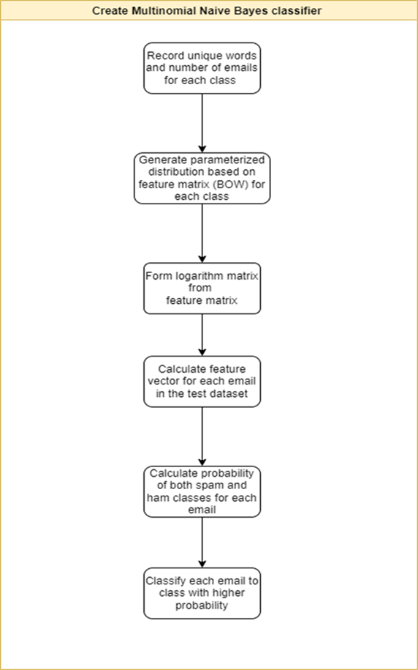
Project Methodology
Pseudo code
Step 1: Record unique words and number of emails for each class (spam and ham specifically)
label_count = np.zeros(2)
for i in labels :
label_count[int(i)] += 1
Step 2: Generate parameterized distribution based on feature matrix (BOW) for each class
class_log_prior = [0.0, 0.0]
class_log_prior[0] = math.log(float(label_count[0])/float(len(labels)))#ham
class_log_prior[1] = math.log(float(label_count[1])/float(len(labels)))#spam
Step 3: Form a logarithm matrix from the feature matrix
smooth_alpha = 1
for j in range(len(features)) :
for k in range(len(features[j])) :
if label is 0
ham[k] += features[j][k]
sum_ham += features[j][k]
else
spam[k] += features[j][k]
sum_spam += features[j][k]
for l in range(most_common_word) :
ham[l] += smooth_alpha
spam[l] += smooth_alpha
sum_ham += smooth_alpha*most_common_word
sum_spam += smooth_alpha*most_common_word
for h in range(most_common_word) :
feature_log_prob[0][h] = math.log(float(ham[h])/float(sum_ham))
feature_log_prob[1][h] = math.log(float(spam[h])/float(sum_spam))
Pseudo code
Step 4: Calculate its feature vector for each email in the test dataset
This has been done in SpamEmailFilter.py, no further actions required
Step 5: Calculate probability of both spam and ham classes for each email
classes = np.zeros(len(features))
ham_prob = 0.0
spam_prob = 0.0
for i in range(len(features))
ham_prob = 0.0
spam_prob = 0.0
for j in range(len(features[i]))
ham_prob += feature_log_prob[0][j]*float(features[i][j])
spam_prob += feature_log_prob[1][j]*float(features[i][j])
ham_prob += class_log_prior[0]
spam_prob += class_log_prior[1]
Step 6: Classify each email to class with higher probability
if ham_prob > spam_prob :
classes[i] = HAM
else :
classes[i] = SPAM

Slide 8
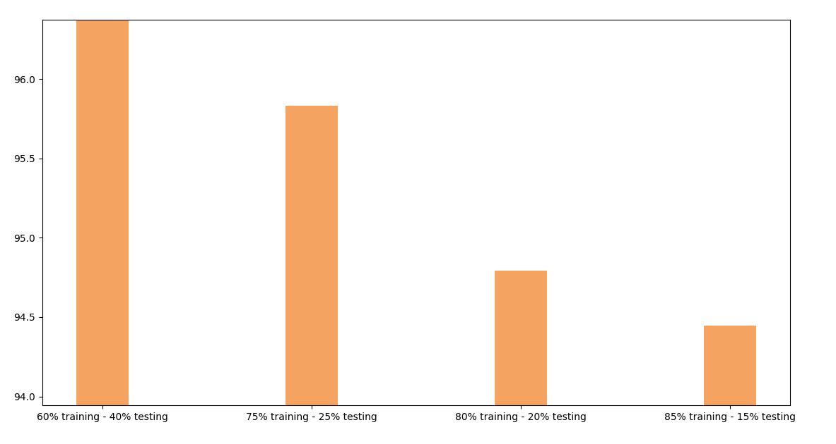
Results
Less testing equates to less accuracy.
Using Multinomial Naive Bayes: (training-testing)
@60-40 we got 96.88% accuracy
@75-25 we got 95.83% accuracy
@80-20 we got 94.79% accuracy
@85-15 we got 94.44% accuracy
The more training the greater most-commons phrases can be found
With 60% training we got 14729 vs 19202 at 85% training

Slide 9
Summary
Cleaned the data set
Implemented the spam email filter process
Found that the 60% training, 40% testing split resulted in the most accurate filter (96.88%)
Applied Multinomial Naive Bayes classifier to test the dataset
Validate the model

